Slide 1
Discrete Mathematics
What is Function?
Function & Tree – Lesson 6
May1st, 2016

Slide 2
Function Requirements
Should there be any rules for function?
There are some rules for functions to be well defined, or correct.
No element of the domain must be left unmapped.
No element of the domain may map to more than one element of the co-domain.

Slide 3
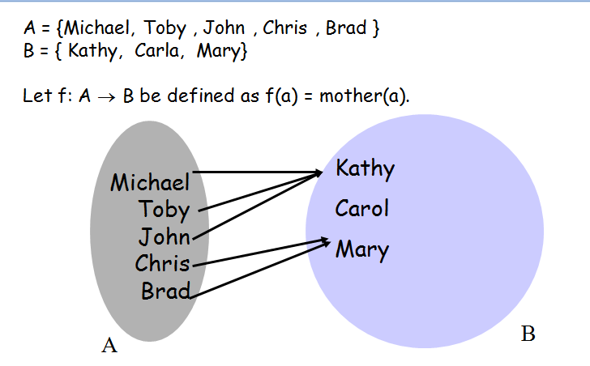
Which one is domain and which one is co-domain?
Can anyone explain the rules in previous slide with this example?

Slide 4
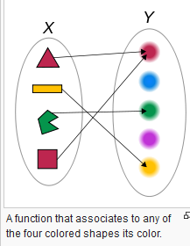
Explain this example also..
The domain of the "color-of-the-shape function" is the set of the four shapes, and the codomain consists of the five colors.
Is it a function?Why?

Slide 5
Function in Mathematics
An example is the function that relates each real number x to its square x².
The output of a function f corresponding to an input x is denoted by f(x) (read "f of x").
In this example, if the input is −3, then the output is 9, and we may write f(−3) = 9. Likewise, if the input is 3, then the output is also 9, and we may write f(3) = 9. (The same output may be produced by more than one input, but each input gives only one output.)

Slide 6
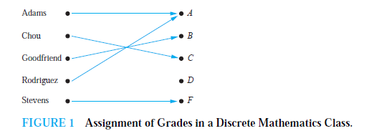
Explain It also…
Is it a function?
Why?

Slide 7
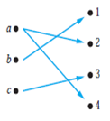
Is it a function? If not state the reasons.

Slide 8
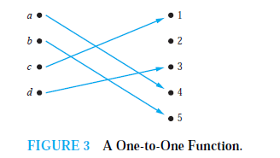
One-to-One
one-to-one or an injunction function never assign the same value to two different domain elements.

Slide 9
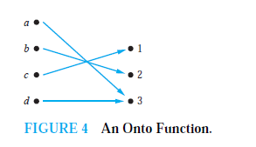
Onto functions
When every member of the co-domain is the image of some element of the domain then functions are called onto functions or a surjection.

Slide 10
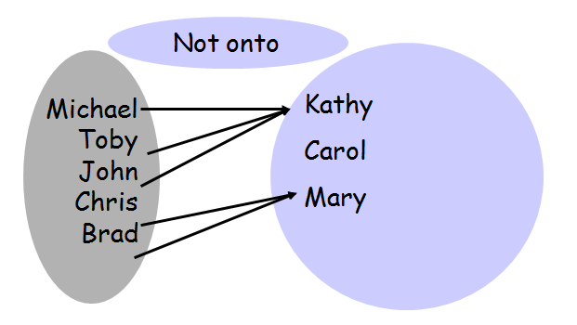
Explain Why?

Slide 11
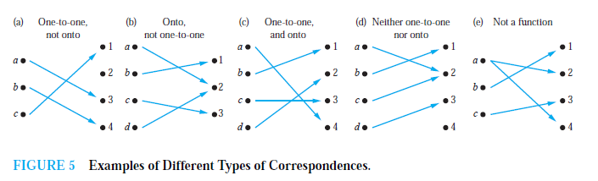
Check these

Slide 12
Bijective (both one-to-one and onto)
If the function is both one-to-one and onto that function is bijective.

Slide 13
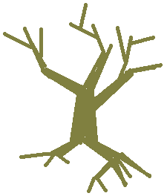
Trees
A very important type of graph in CS is called a tree:
Real
Tree
transformation
L23
13

Slide 14
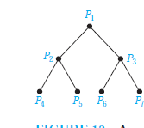
Rules for Tree
A tree with n vertices has n − 1 edges.

Slide 15
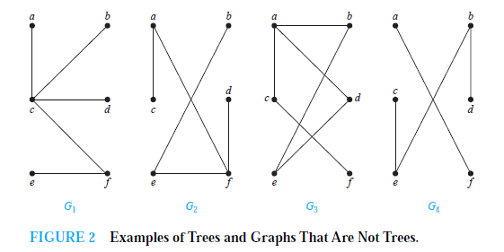
Find Tree or not.
A tree is a connected undirected graph with no simple circuits.
Find which of them are not trees and why!

Slide 16
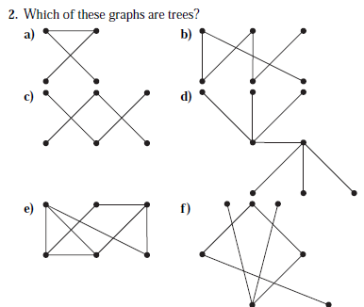

Slide 17
Spanning Trees
Let G be a simple graph. A spanning tree of G is a subgraph of G that is a tree containing every vertex of G.
A simple graph with a spanning tree must be connected, because there is a path in the spanning tree between any two vertices.

Slide 18
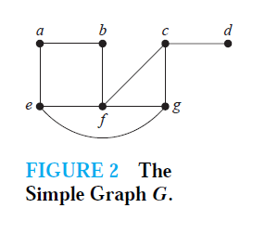
Produce spanning tree from simple graph G

Slide 19
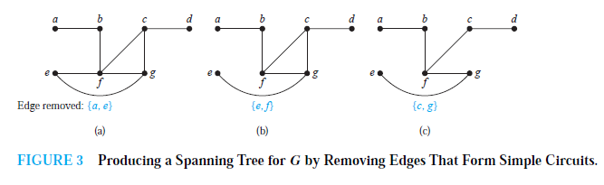
Producing Spanning Tree

Slide 20
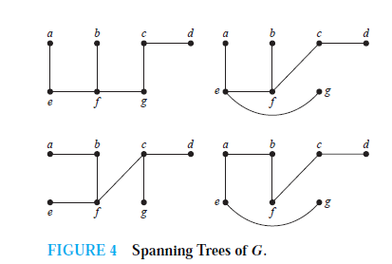
Other 4 Spanning trees of G

Slide 21
Minimum Spanning Trees
A minimum spanning tree in a connected weighted graph is a spanning tree that has the smallest possible sum of weights of its edges.

Slide 22
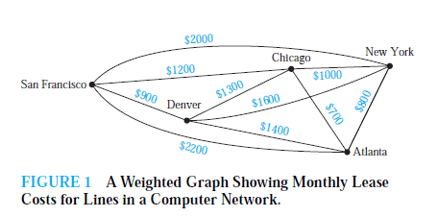
Find Minimum Spanning Tree

Slide 23
We will discuss two algorithms for constructing minimum spanning trees.

Slide 24
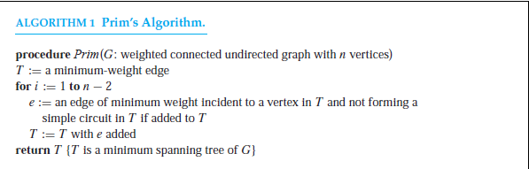
Prim’s Algorithm

Slide 25
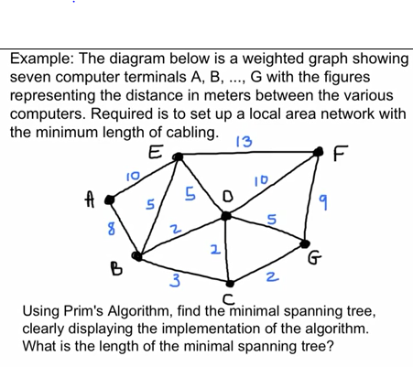

Slide 26
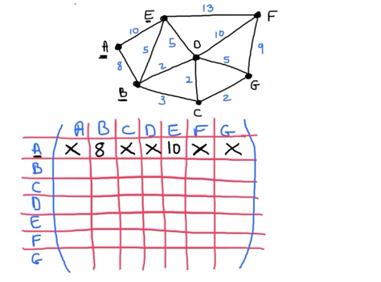

Slide 27
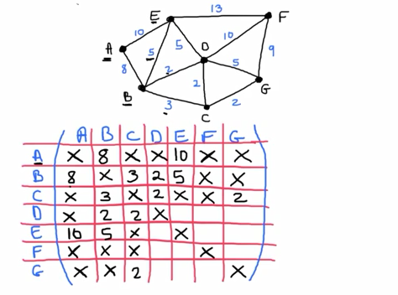

Slide 28
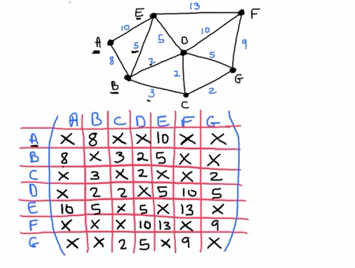

Slide 29
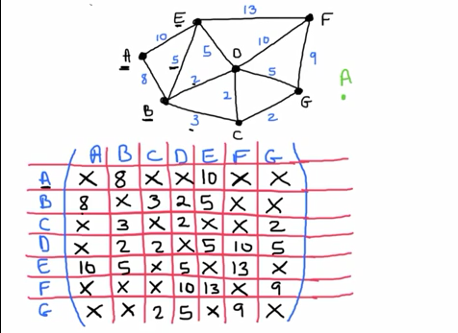

Slide 30
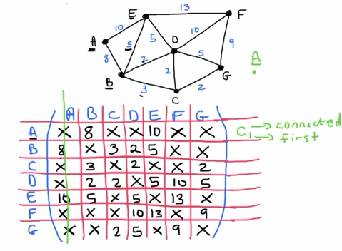

Slide 31
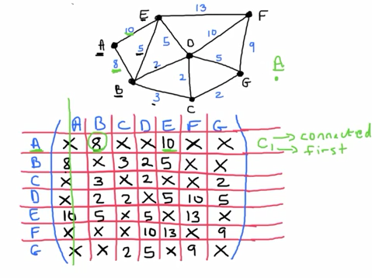

Slide 32
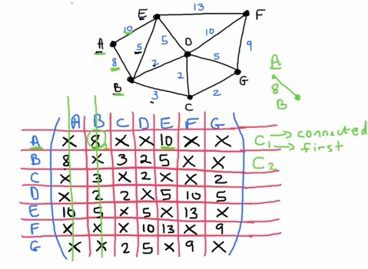

Slide 33
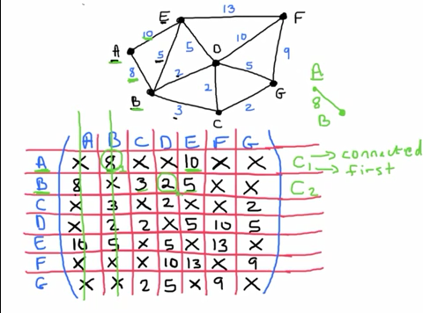

Slide 34
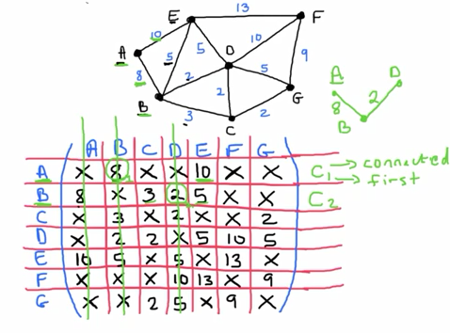

Slide 35
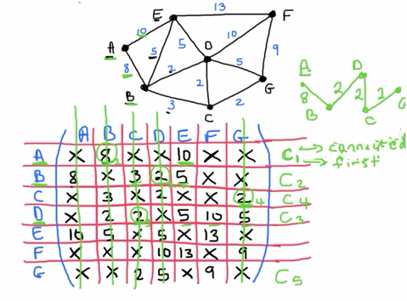

Slide 36
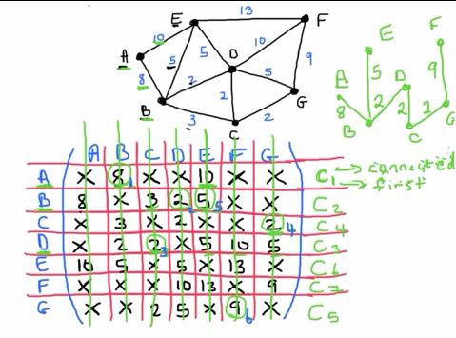

Slide 37
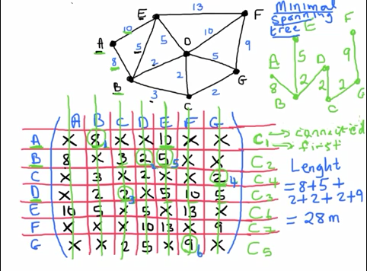

Slide 38
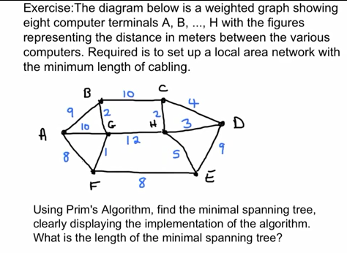

Slide 39
Find Minimum Spanning Tree

Slide 40
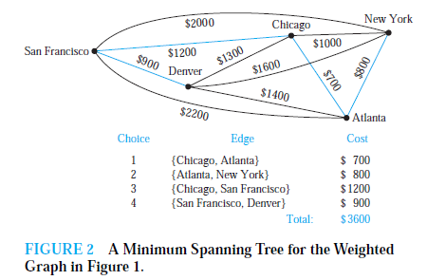
Solution

Slide 41
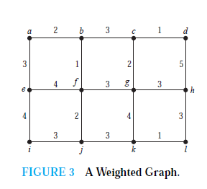
Try this

Slide 42
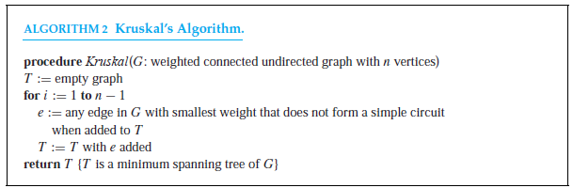
Kruskal’s Algorithm

Slide 43
